Slide 1


Slide 2
A Project Report On
“Cricket World Cup”
SUBMITTED BY:-
Sankalp Kumar Sahoo (230720100072)
Sarat Kumar Sahoo (230720100096)
Prajna Priyadarsini Parida (230720100090)
Itishree Guru (230720100066)
Pallabi Kar (230720100094)
Under the guidance of
SUBHAM SAHU
Submitted in partial fulfilments for the
MASTER IN COMPUTER APPLICATION
IN
ENGINEERING AND TECHNOLOGY
CENTURION UNIVERSITY OF TECHNOLOGY AND MANAGEMENT
Bhubaneswar Campus Ramchandrapur, po-Jatni, Bhubaneswar,
Khurdha, Odisha, India-752050

Slide 3
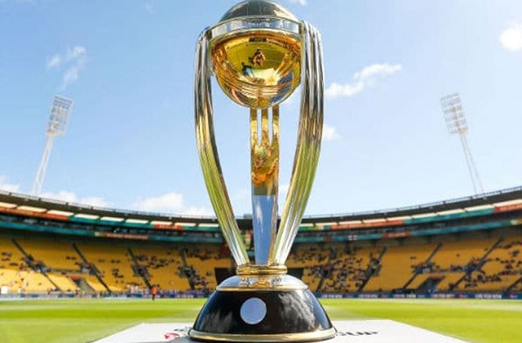
Contents
Introduction
Format of the tournament
Key Statistics
Conclusion

Slide 4
Introduction
The ICC Men's Cricket World Cup 2023 is the 13th edition of the premier international cricket tournament. Scheduled to be held in India, it features the world's top cricket teams competing in One Day International (ODI) matches. The tournament is a showcase of cricketing excellence and a highly anticipated event, with teams vying for the coveted title.

Slide 5
Format of the Tournament
Number of teams participating
The tournament usually features 10 to 14 teams, representing cricket-playing nations from around the globe.
Round-robin stage
The teams compete against each other in a round-robin format,playing a predetermined number of matches to determine the top teams.
Knockout stage
The top teams from the round-robin stage move on to the knockout stage, which includes intense semifinals and a thrilling final match to decide the champion.
Final Match
The final match is the pinnacle of the tournament, with two teams battling it out under immense pressure to lift the coveted trophy.

Slide 6
Main Keys
World Cup Participating Teams
World Cup Team Playing
Country Host Each ICC World Cup
Who Won the World Cups
World Cup Venue
Highest Total In An Innings In Each World Cup
Lowest Total Score In Each World Cup
World Cup Records
Top Wicket Takers in Each World Cups
Number Of Viewership In Each World Cup
Top 10 Scorer In Each World Cup
Top 10 Wicket Taker World Cup
Top Scorers In Each World Cups
World Cup Winner List
Top 10 Sixers In Each World Cup
Official Broadcaster

Slide 7
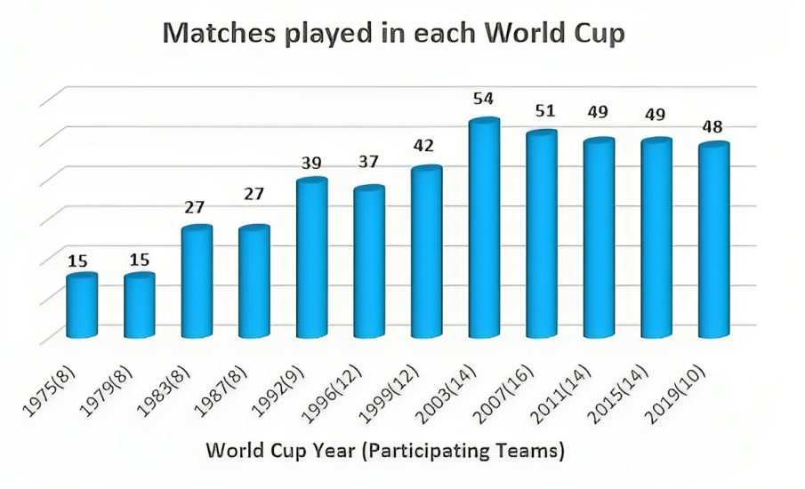
ICC Cricket World Cup Statistics
WCs Participating Teams
In 10 mega events 19 total teams appeared in world cups so far. 2007 ODI world cup featured more teams, 16. Totally 356 matches have been played in world cups and 2003 event hosted the most matches individually, 54.

Slide 8
World Cup Team Playing
INDIA
PAKISTAN
AFGHANISTAN
NEW ZEALAND
AUSTRALIA
NETHERLANDS
ENGLAND
SOUTH AFRICA
BANGLADESH
SRI LANKA

Slide 9
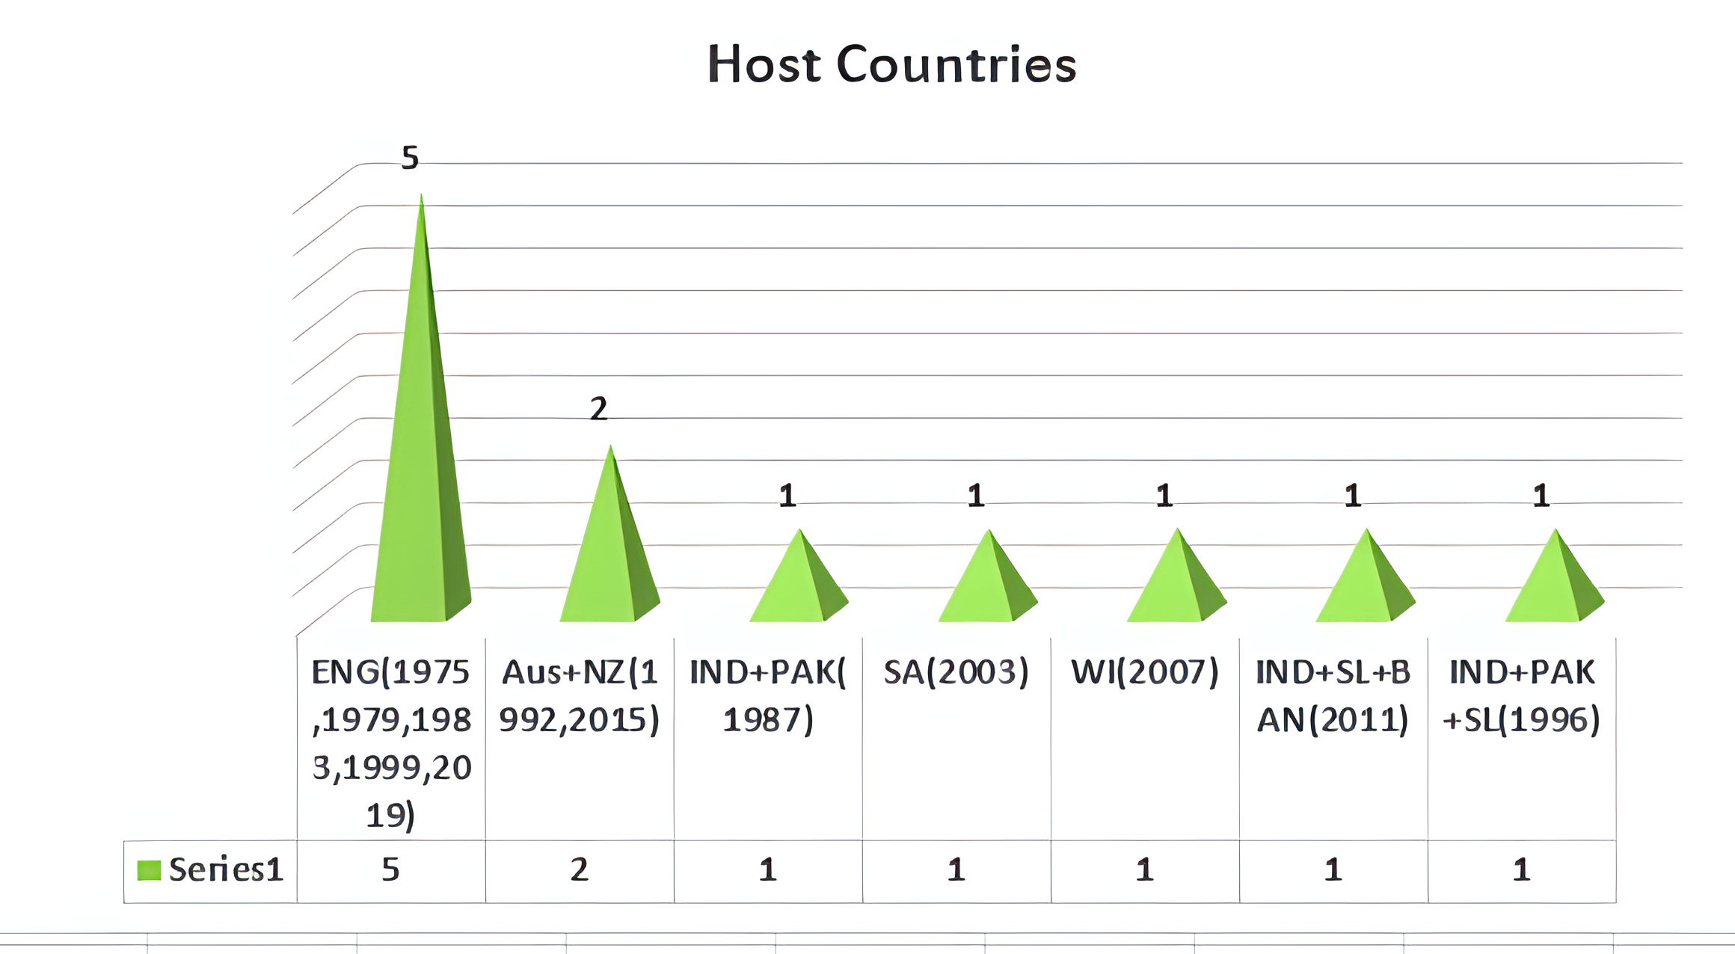
Country Host Each ICC World Cup England have hosted the most World Cups – a total of 5 (including the first three World Cups).

Slide 10
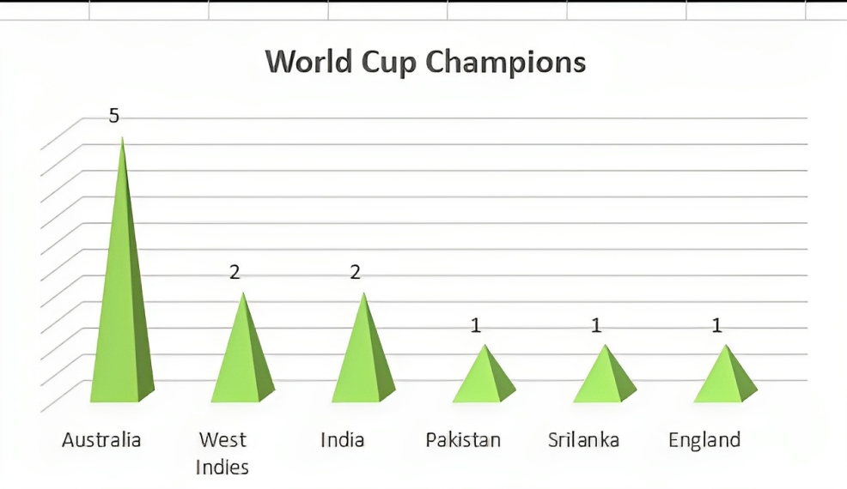
Who won the world cups
Australia is the most successful team in the ICC ODI World Cup which has won the World Cup 5 times and finished as the runner-up 2 times.

Slide 11
World Cup Venue
HPCA Stadium
(Himachal Pradesh)
BRSABV Ekana Cricket Stadium
(Lucknow)
Capacity:23,000
Capacity:50,000
Arun Jaitley Stadium
(Delhi)
Edan Gardens
(West Bengal)
Capacity:5 5,000
Capacity:66,000
Narendra Modi Stadium
(Ahmedabad)
Rajiv Gandhi International Cricket Stadium
(Hyderabad)
Capacity:132,000
Wankhede Stadium
(Maharashtra)
Capacity:55,000
M A Chidambaram Stadium
(Tamil Nadu)
Capacity:33,000
MCA International Stadium
(Pune)
Capacity:38,000
M Chinnaswamy Stadium
(Karnataka)
Capacity:37,000
Capacity:38,000

Slide 12
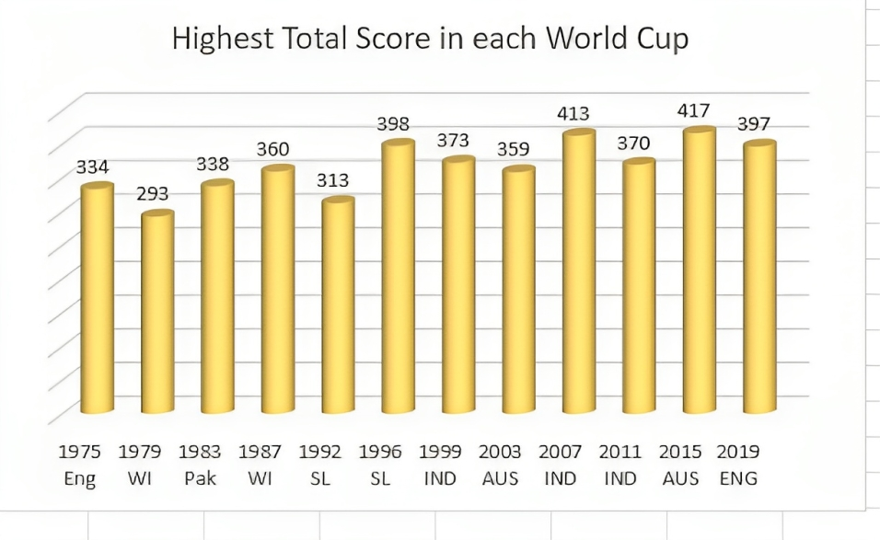
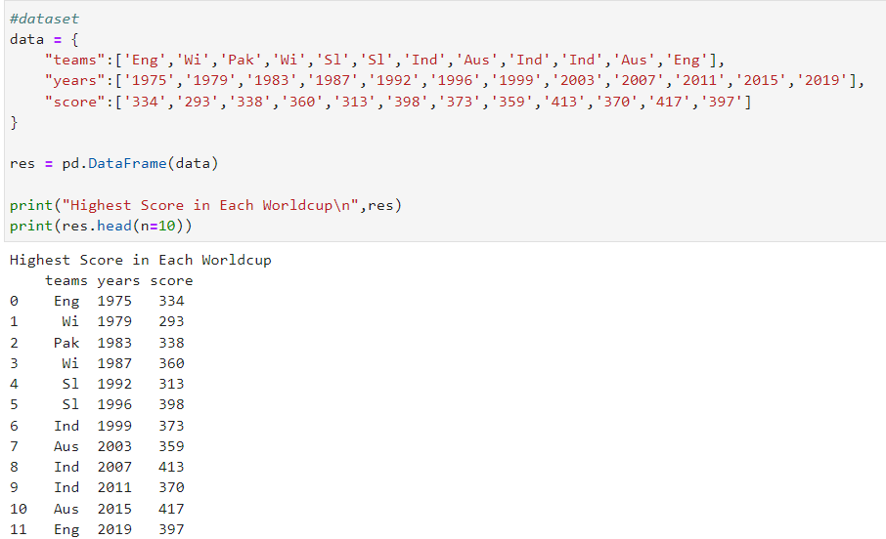
Highest Total in an Innings in each World Cup
We see high scoring games every now and then. Following chart shows the highest score in each world cup in an innings by any team.

Slide 13
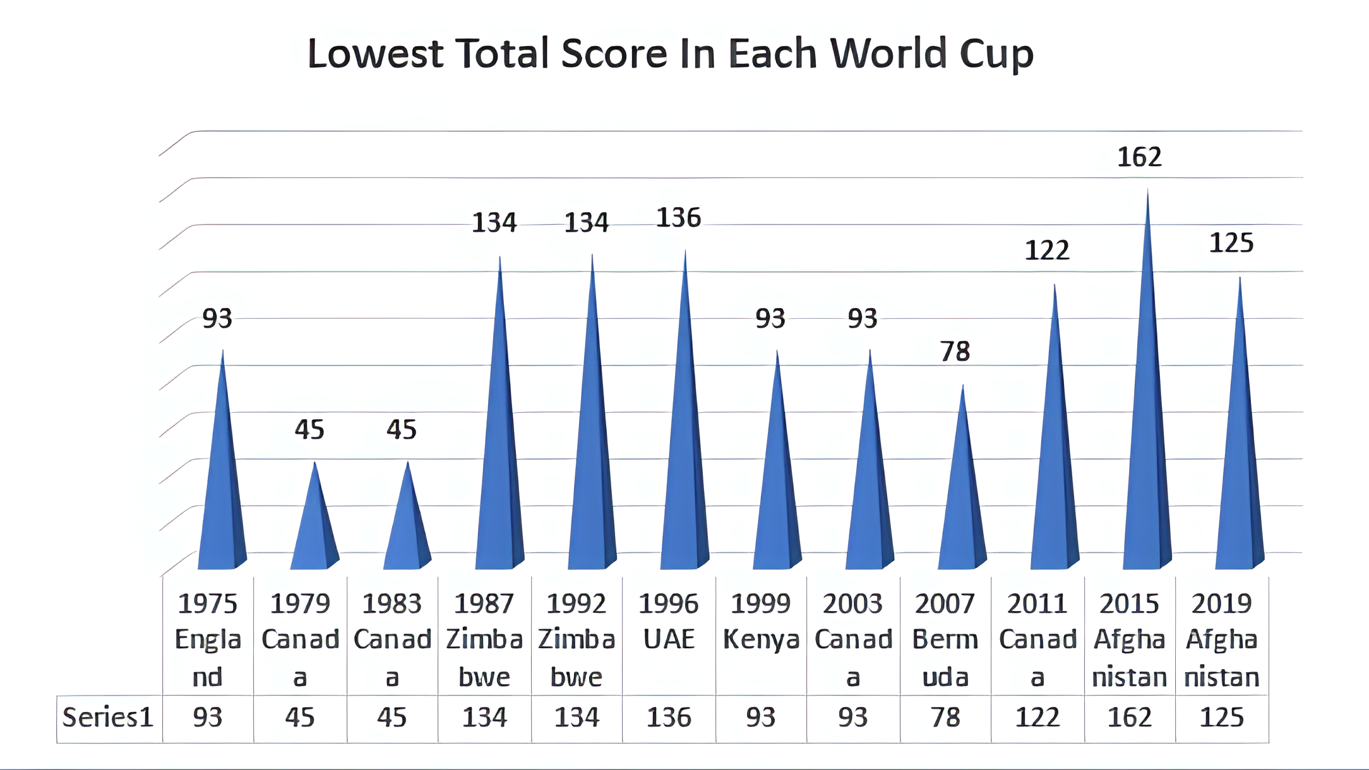
Lowest Total Score In Each World Cup
Canada tops the list with a shockingly low score of 36 against Sri Lanka in the 2003 edition of the World Cup. In second place is again, in the 1979 World Cup, Canada was bowled out for 45 runs in 40.3 overs by England in the first innings.

Slide 14
World Cup Records
Most Runs
Most Wickets
2,278
71
SACHIN TENDULKAR
GLENN McGRATH
(1992–2011)
(1996–2007)
Most dismissals (wicket-keeper)
Most Catches (Fielder)
54
28
KUMAR SANGAKKARA
RICKY PONTING
(2003-2015)
(1996-2011)
Highest Score (Team)
Lowest score (Team)
417/6
36/10
AUSTRALIA vs AFGHANISTAN
CANADA vs SRI LANKA
(2015)
(2003)

Slide 15
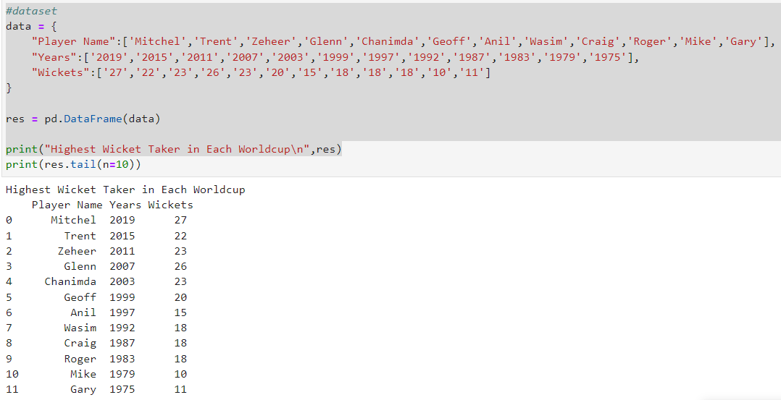
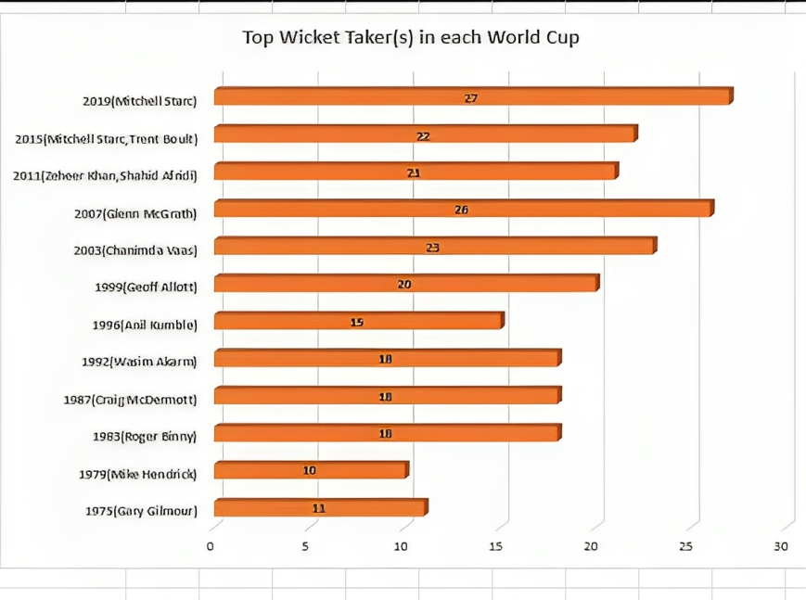
Top Wicket Takers in each World Cups
In 2019, Mitchell Starc collected 27 Wickets and became top wickets taker in all WCs. All world cups top wicket takers are shown in graph below:

Slide 16
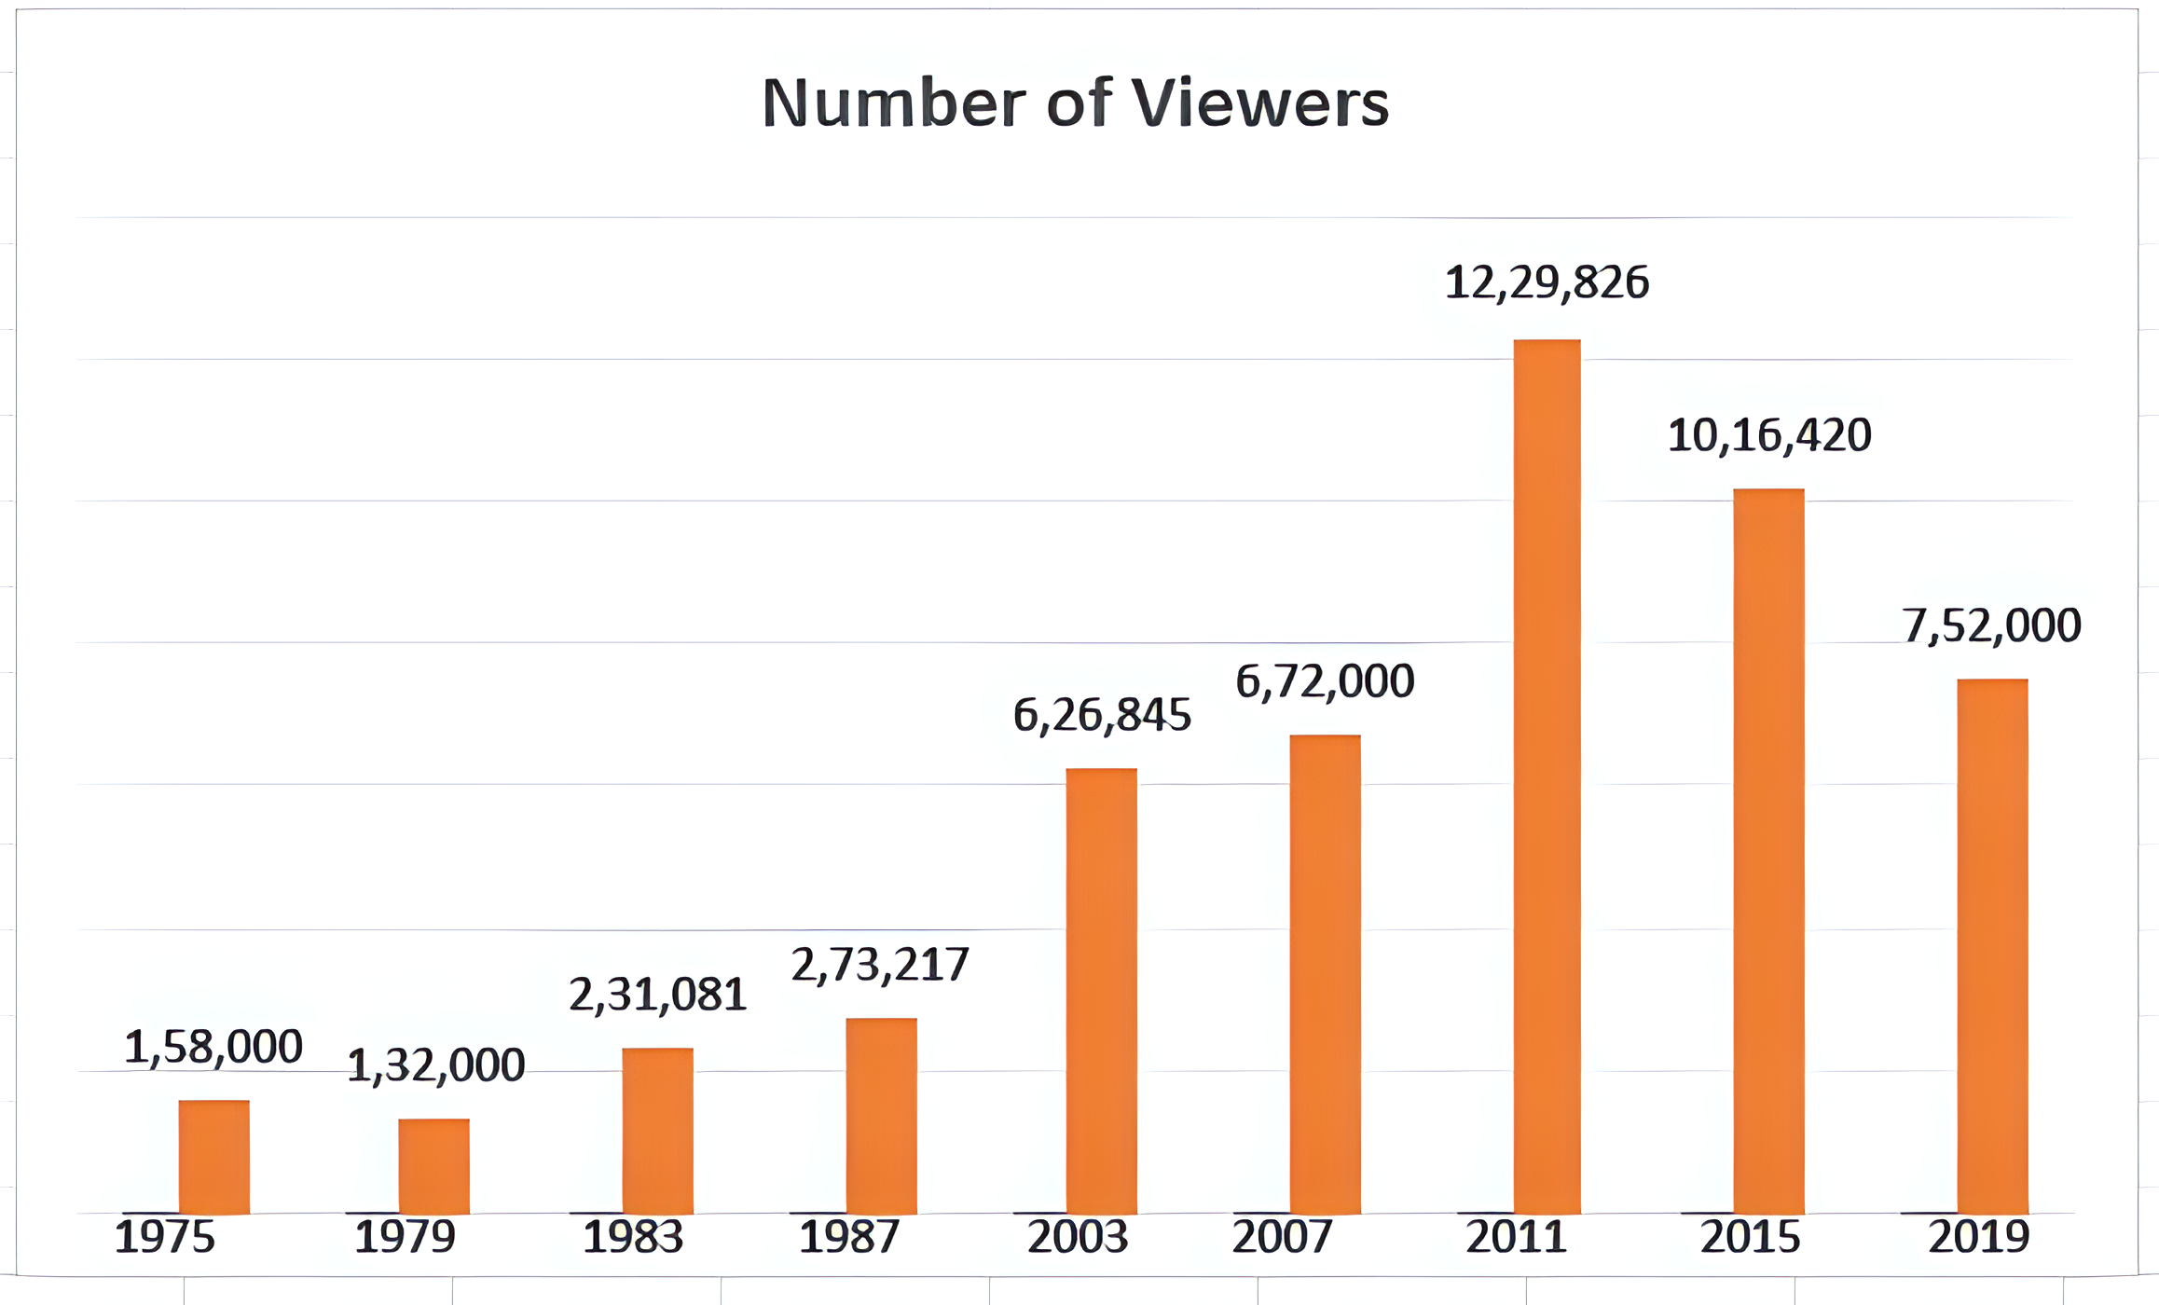
Number of Viewership In Each World Cup
(excluding online streaming platform views) The Viewership in Icc World Cup rises gradually till the year 2011 and after that in 2015 and 2019 it decreases.

Slide 17
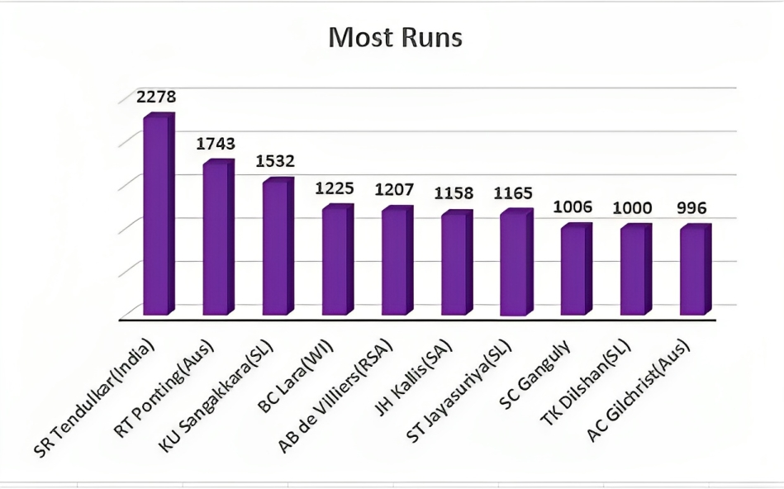
Top 10 scorer in World Cups
Sachin Tendulkar career is spread over 6 world cups tournaments. Little master scored 2275 runs and Ponting is at second number with 1743 runs. Rest of the players in list has not much difference to the closer player as you can see in following chart.

Slide 18
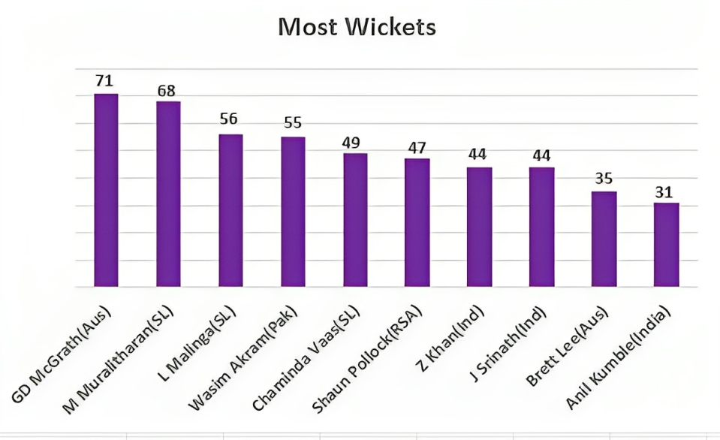
Top 10 Wicket Takers in World Cups
Mcgrath and Murlithran lead this list with 71 and 68 wickets respectively. Have a look at top 10 bowlers from world cup tournaments:

Slide 19
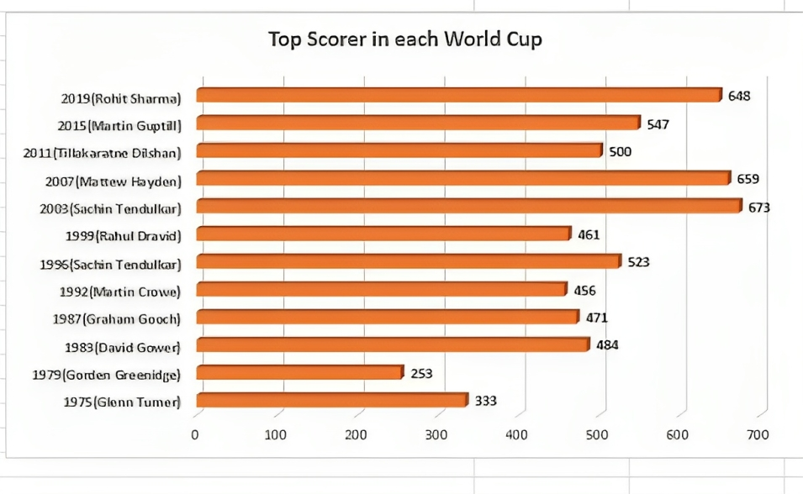
Top Scorer in each World Cups
In 2019, Rohit Sharma scored 500 runs and was leading scorer in world cup. Now look out some other top Scorers.

Slide 20
World Cup Winner List
YEAR
WINNER
HOSTING COUNTRY
RUNNER-UP
1975
West Indies
England
Australia
1979
West Indies
England
England
1983
India
England
West Indies
1987
Australia
India and Pakistan
England
1992
Pakistan
Australia and New Zealand
England
1996
Sri Lanka
India and Pakistan
Australia
1999
Australia
England
Pakistan
2003
Australia
South Africa
India
2007
Australia
West Indies
Sri Lanka
2011
India
India and Bangladesh
Sri Lanka
2015
Australia
Australia and New Zealand
New Zealand
2019
England
England and Wales
New Zealand

Slide 21
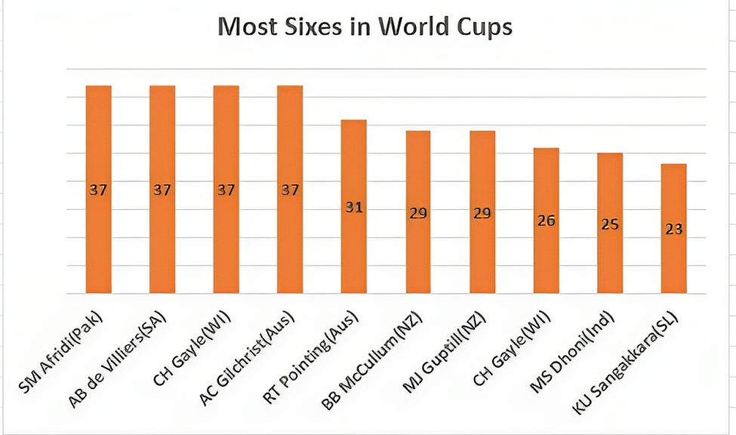
Top 10 Sixers in ICC WCs
Before you scroll down, wait a sec. Lets check out the most sixes hitted by the players.

Slide 22
Official Broadcaster
TERRITORY
LICENSEE
Afghanistan
Ariana TV
Australia
Fox Sports Channel Nine
Bangladesh
Gazi TV T-Sports
Canada
Willow TV
Caribbean Islands
ESPN C
India
Disney Star
New Zealand
Sky Sport NZ
Pakistan
PTV , ARY
South Africa and Sub-Saharan Africa
Super Sport
UK
Sky Sports Channel 5 (Highlights only)
USA
ESPN + Willow
https://www.cricketworldcup.com/official-broadcasters

Slide 23

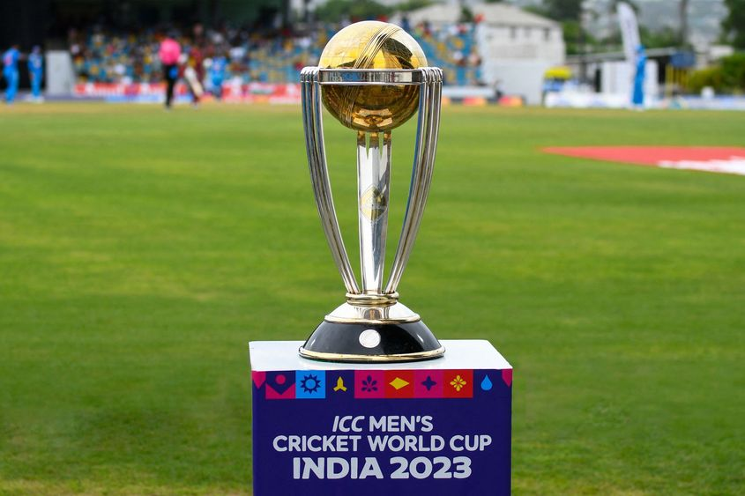
Conclusion
The Cricket World Cup is much more than a cricket tournament. It represents the pinnacle of the sport, showcasing skill, passion, and the spirit of competition. As we look forward to future tournaments, let’s celebrate the rich history and vibrant legacy of the Cricket World Cup!

Slide 24
Question and Answer
Session ?

Slide 25


